Slide 1
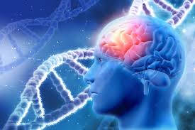
Deep learning model in analysing the Genetic variation associated with the occurrence and progression of Neurodevelopmental disorders
Project Proposal

Slide 2
Team Members
COMPUTER SCIENCE | LIFE SCIENCE
Dr. S. Pitchumani Angayarkanni Associate Professor, Department of Computer Science Lady Doak College | Dr. S. Kalaivani Priyadarshini, Assistant Professor, Department of Biotechnology, Lady Doak College
Dr. Sofia, Associate Professor, Department of Computer Science, Lady Doak College. | Ms. Raga Priya UG Student Bioinformatics TN Agricultural university. Coimbatore

Slide 3
Final Dataset
Neurodevelopmental Disorder | Manual Dataset- NCBI | Web Scrapping | After Preprocessing
ADHD | 172 | 180 | 166
AUTISM | 37 | 40 | 37
Cerebral Palsy | 51 | 60 | 50
Muscular Distrophy | 63 | 62 | 63
 |  | Total | 316

Slide 4
Dataset Validation
Prevalent Genes
Homosapines

Slide 5
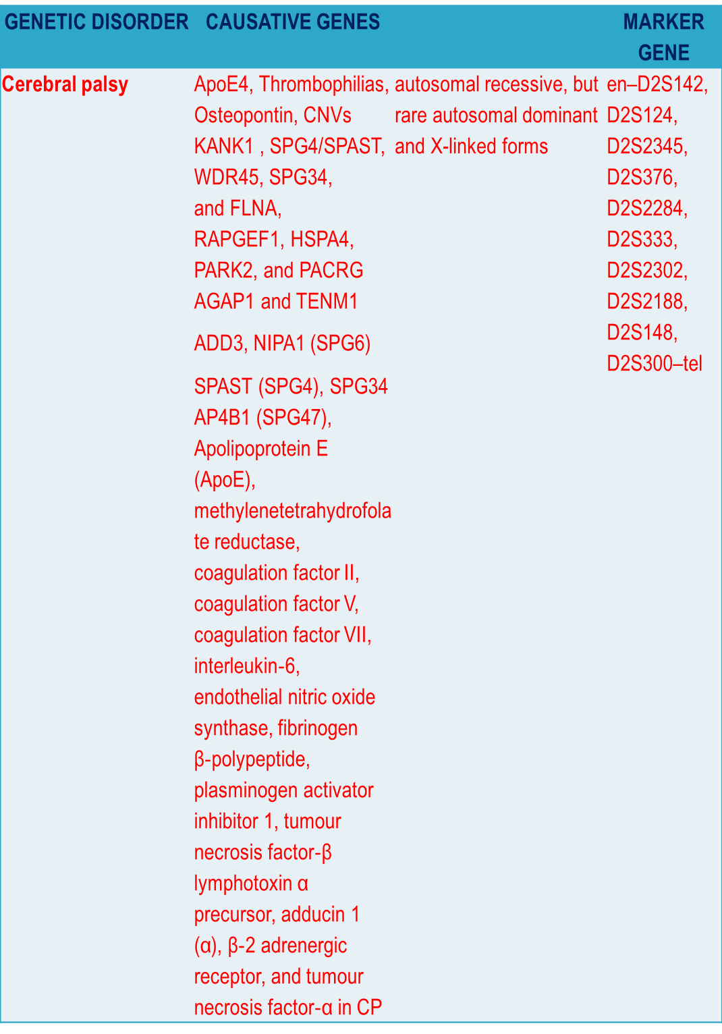

Slide 6
Autism | NLGN3 and NLGN4 SHANK3 | synaptic genes such as SynGAP and DLGAP2
ADHD | Attention Deficit Hyperactivity Disorder (ADHD) in boys affected by Duchenne muscular dystrophy (DMD) . One-third of all fathers who had ADHD in their youth have children with the condition. | ADHD and a dopamine D4 receptor gene VNTR and a dopamine D5 receptor gene microsatellite marker

Slide 7
Dataset Preparation Method
Retrieval of Gene Sequence using bioscarping
Convert the txt file by splitting the content to csv using pandas and file concepts
Apply NLP technique to description filed

Slide 8
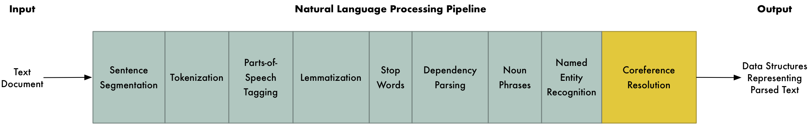
Apply NLP technique to description filed
Filter the sequence based on gene matching

Slide 9
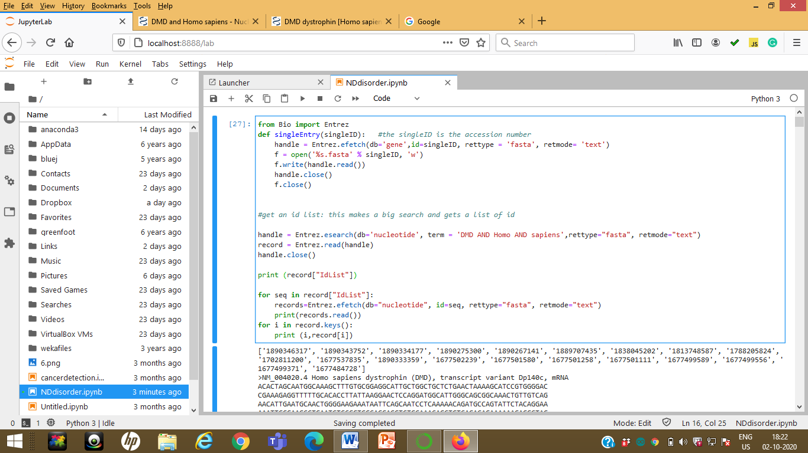
Results & Discussion
Sequence retrieval

Slide 10
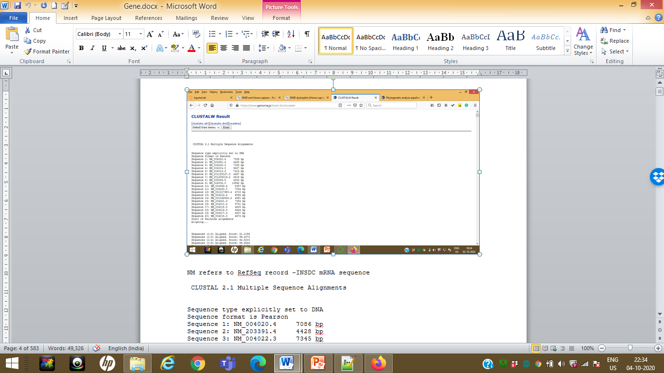
ClustalW – Multiple Sequence Alignment

Slide 12
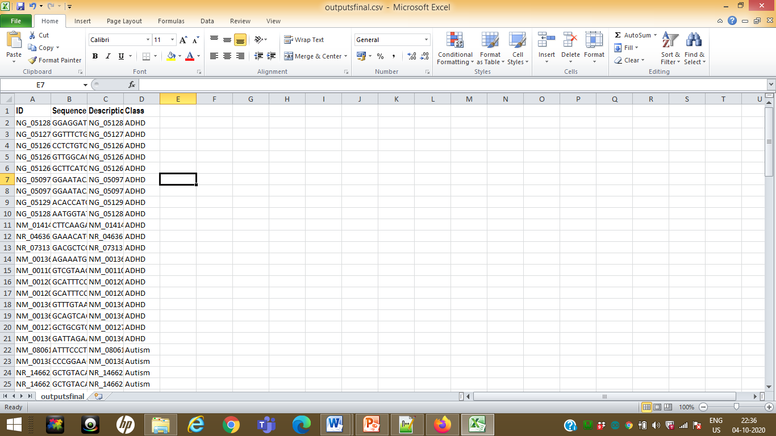
Final Dataset after Preprocessing

Slide 13
Total Dataset
NDD | Total Dataset with gene sequence
ADHD | 26
AUTISM | 30
CP | 32
DMD | 48
Total | 136

Slide 14
ClustalW – Multiple Sequence Alignment
http://www.ebi.ac.uk/Tools/services/web/toolresult.ebi?tool=clustalo&jobId=clustalo-E20201004-132642-0438-84756034-p1m

Slide 15
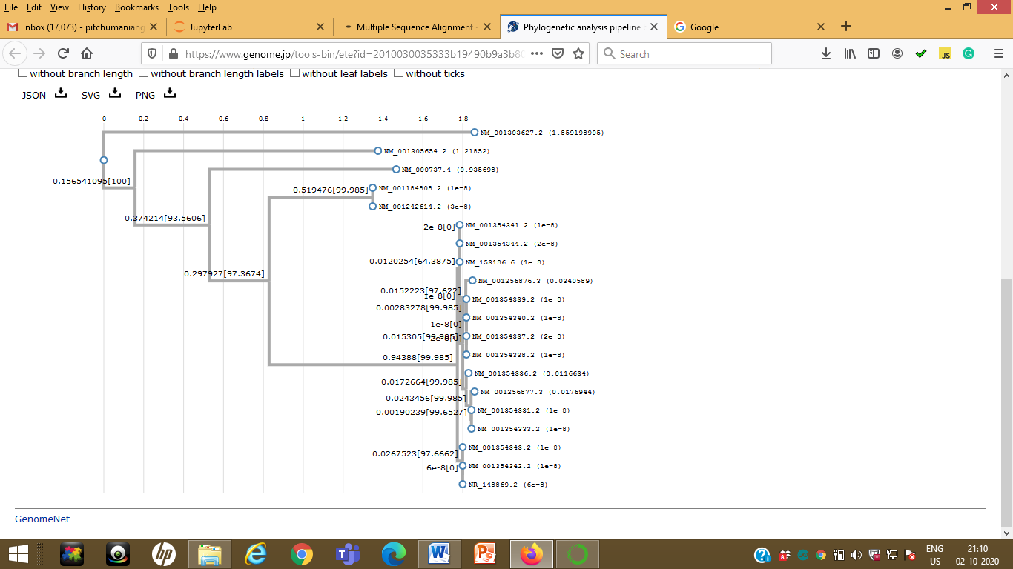
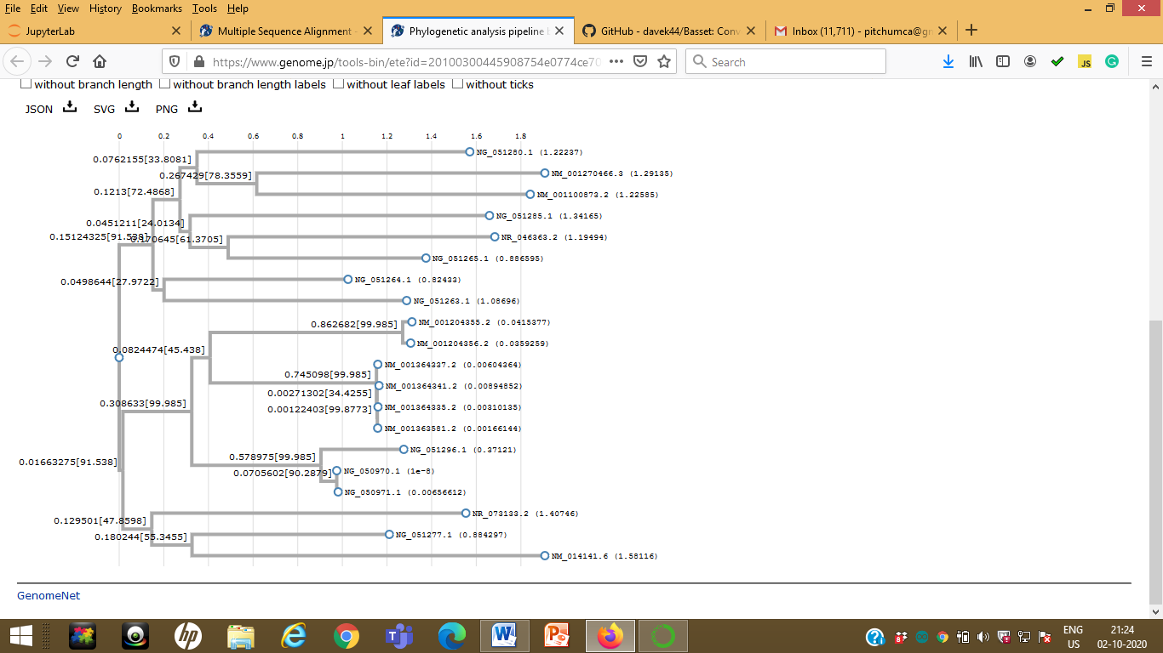
Phylogenetic Tree
ADHD
CP

Slide 16
NDD | Total Dataset with gene sequence
ADHD | 21
AUTISM | 18
CP | 20
DMD | 40
Total | 99

Slide 17
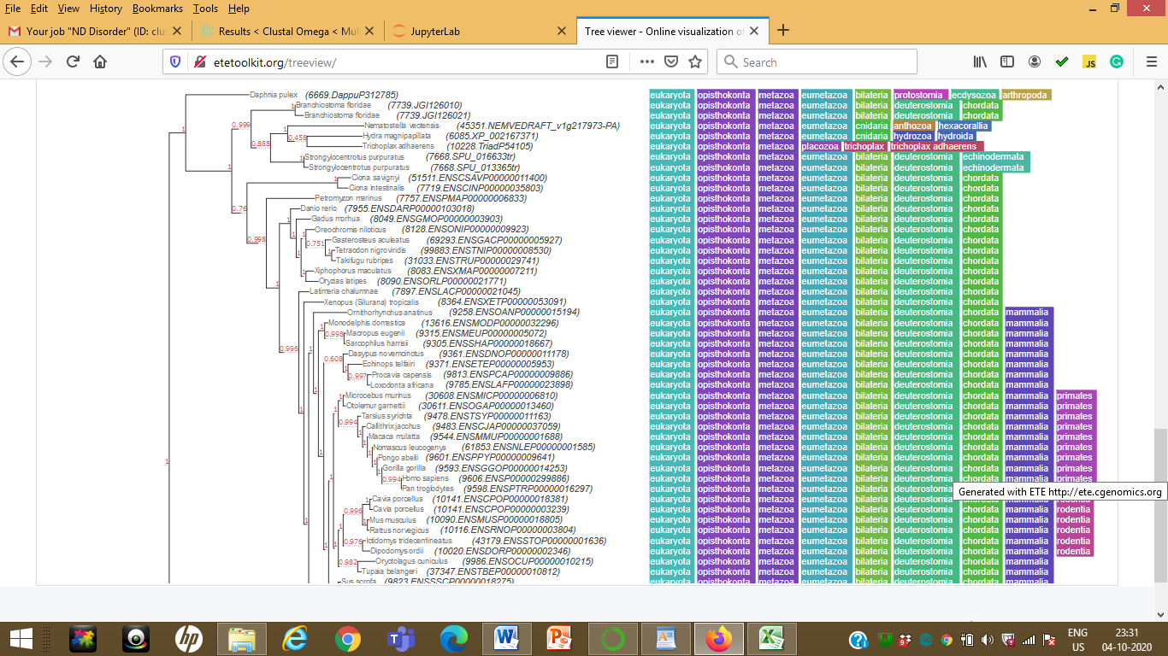

Slide 18
Deep Learning model for Sequence Classification

Slide 19
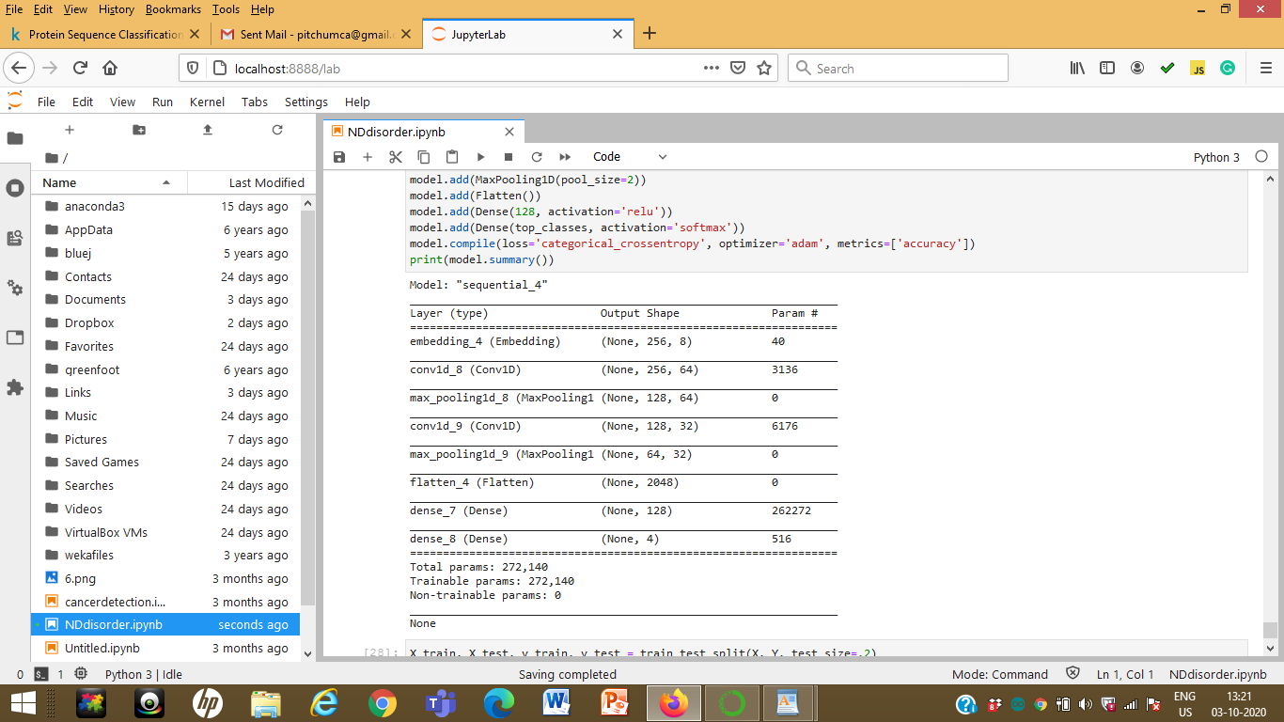

Slide 20
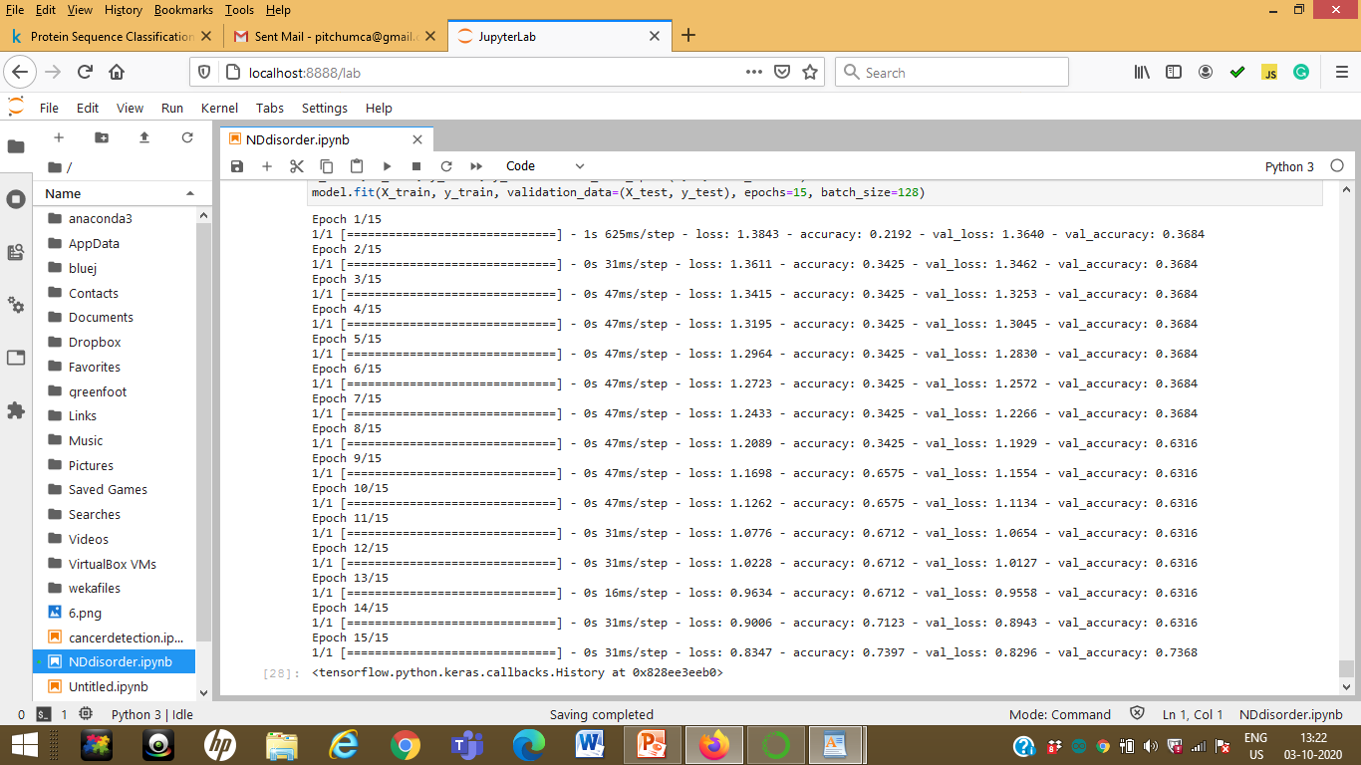

Slide 21
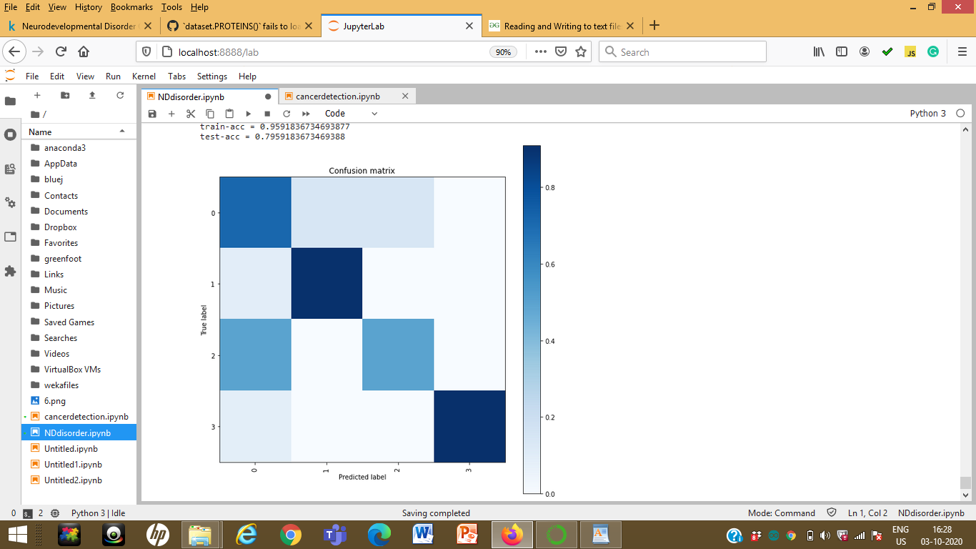

Slide 22
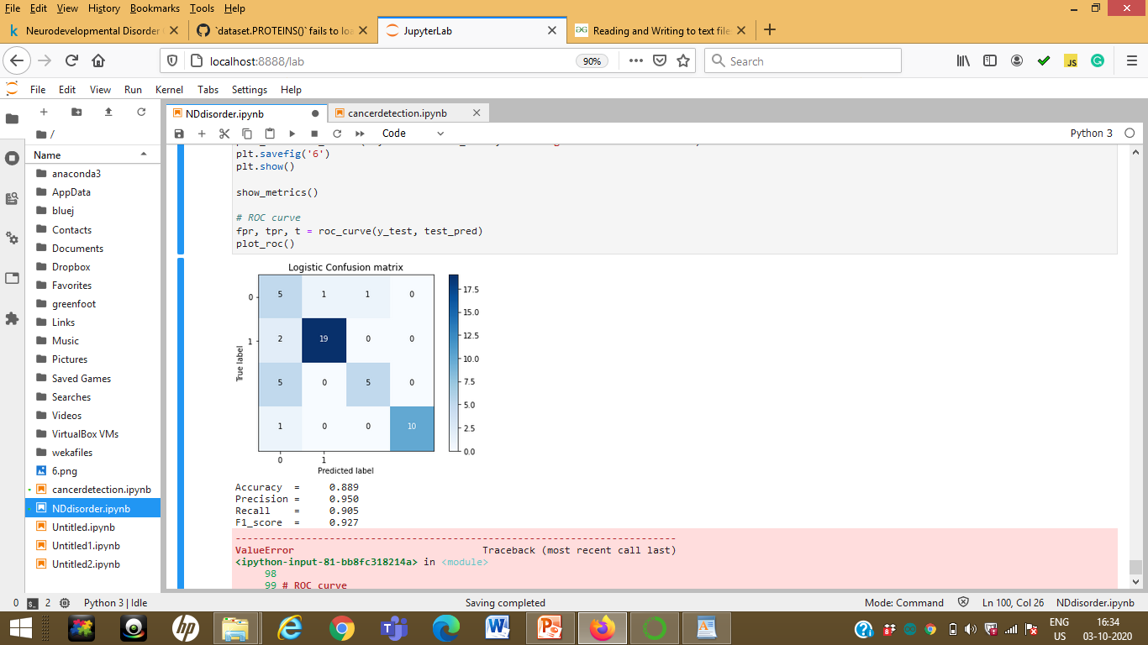

Slide 23
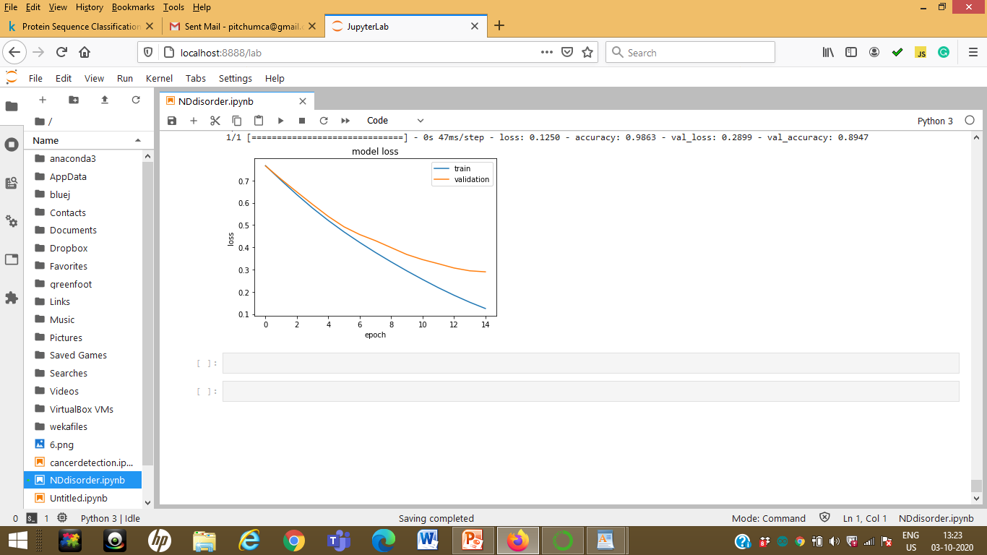

Slide 24
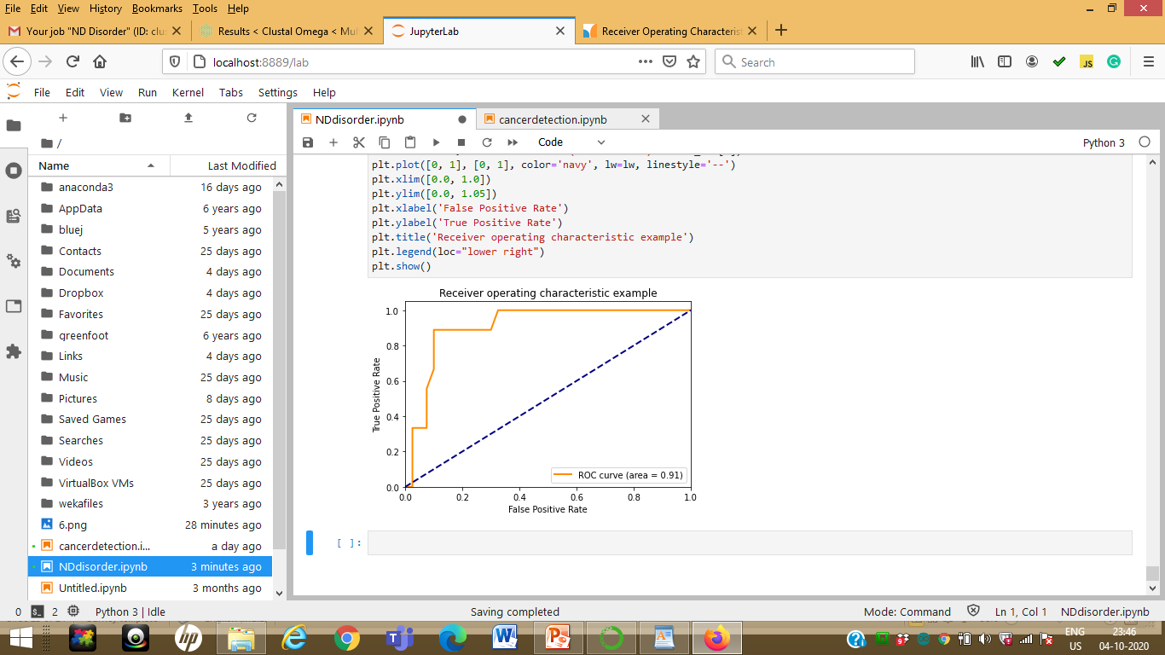

Slide 25
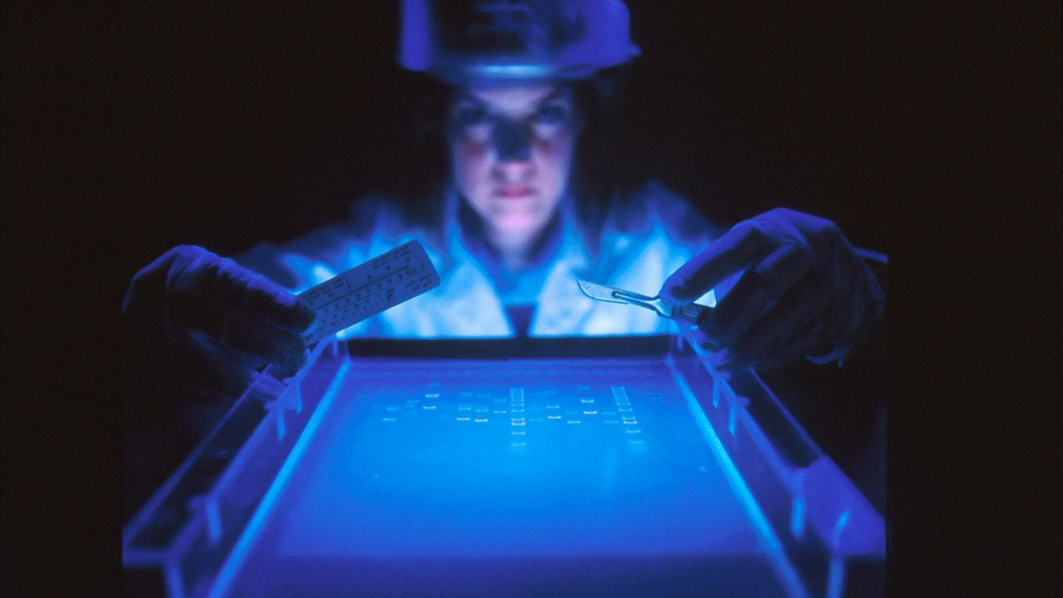
THANK YOU

